Slide 1

Sensor
Chapter 6 and more!

Slide 2
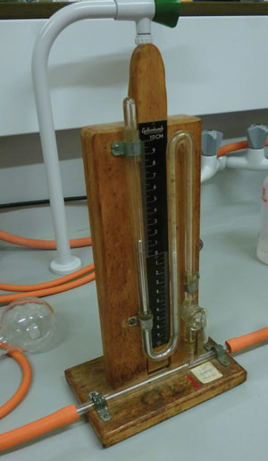
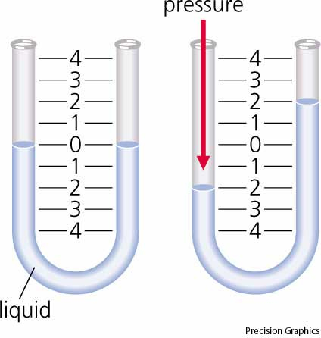
Manometer
Measures pressure

Slide 3
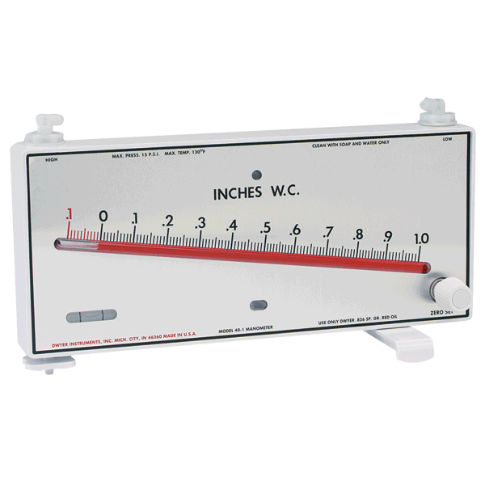
Sensitivity
U-tube Manometer
Less sensitive
Greater range
Inclined Manometer
More sensitive
Less range
http://www.dwyer-inst.com

Slide 4
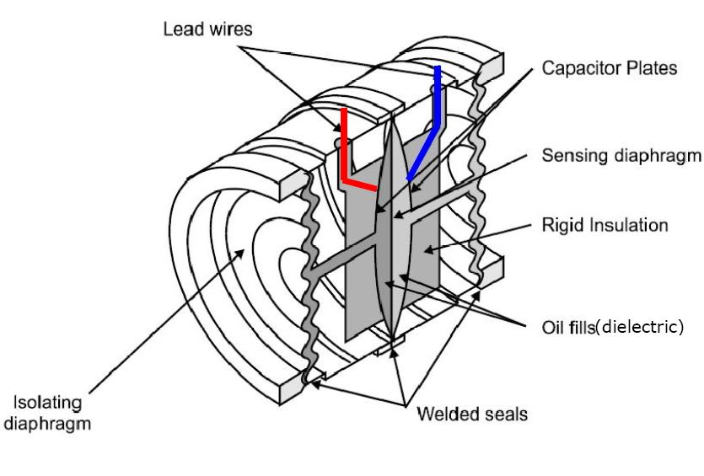
Capacitive Pressure Transducer
Pressure pushes capacitor plates closer together
Capacitive presssure sensor
C_{OUT}
Capacitance-to-voltage IC chip
V_{OUT}

Slide 5
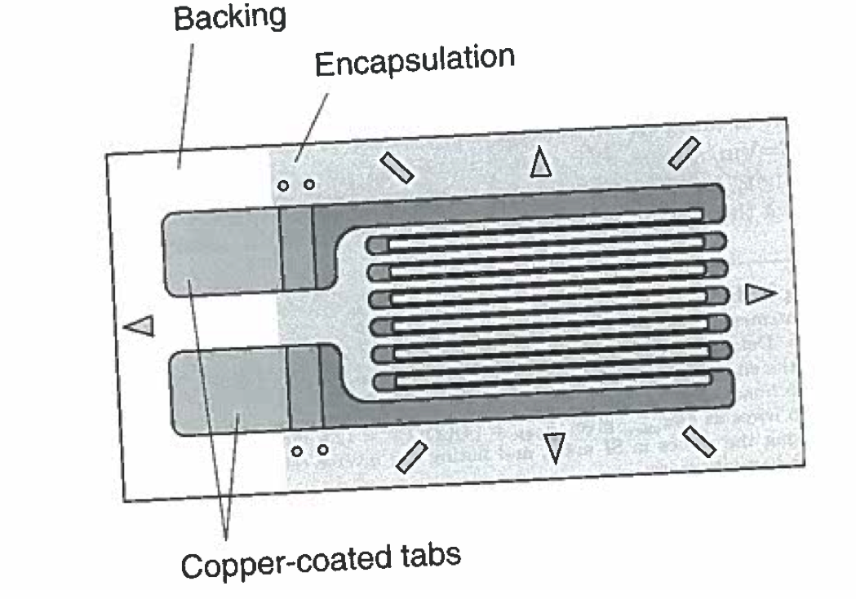
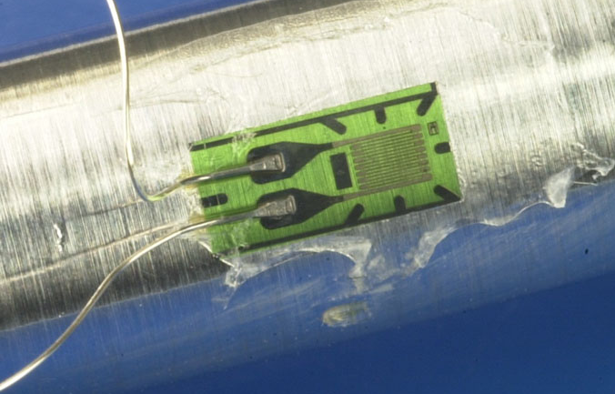
Strain Gauge (or Gage)
Measures strain based on change in resistance
G_{e} ≈ 2 “gage factor”
Fig. 4.4
Often wired up in a Wheatsone bridge configurartion

Slide 6
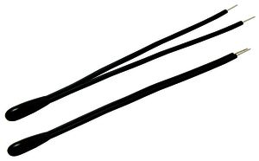
Thermistor
Works the same as an RTD, except the sensing material is made of a ceramic or a semiconductor.
Steinhart Eq.
Non-linear response

Slide 7
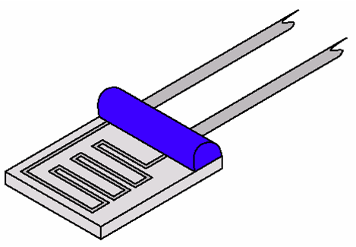
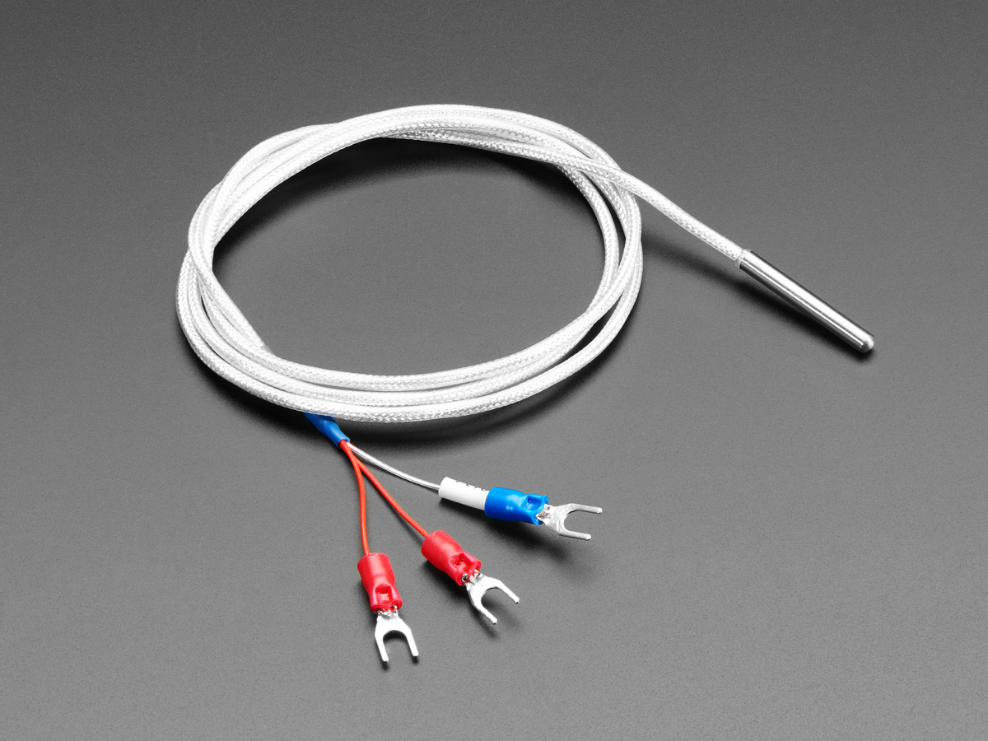
RTD – Resistance Temperature Detector
The resistivity of a metal changes linearly with temperature.

Slide 8
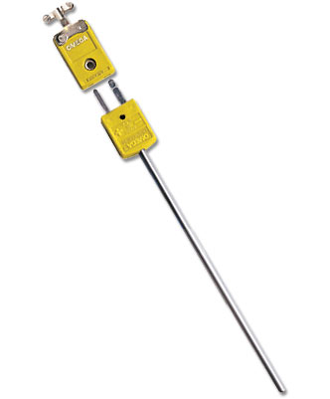
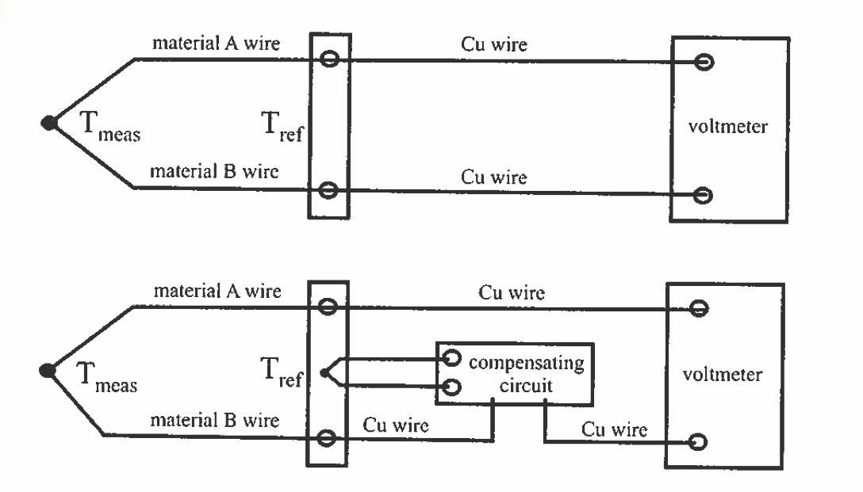

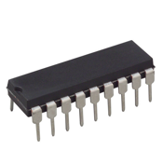
Thermocouple
Uses the thermoelectric effect to convert temperature to voltage.
Two different metals form a junction – Seebeck effect
Thermocouple “type” refers to what metals it uses (Type K, Type J, etc.)
1% accuracy over a wide a temperature range!
Omega.com
Fig. 4.18
IC chip to amplify and linearize the output such that V = (10 mV/C)*T

Slide 9
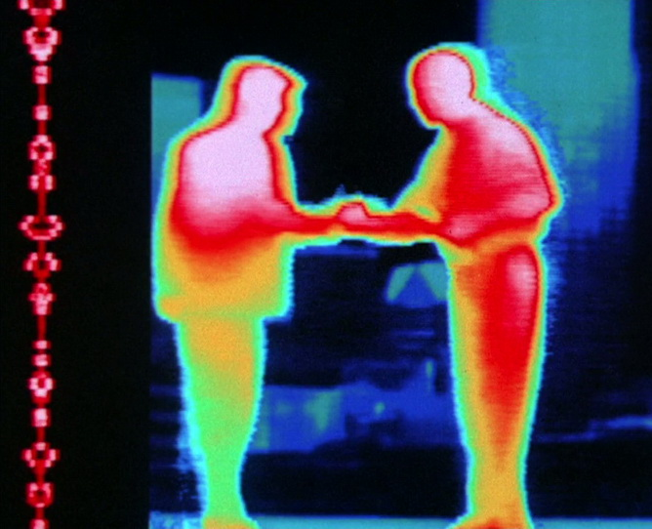
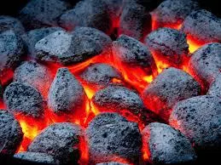

Black Body Radiation
Warm objects emit “black body radiation”.
T~300K Infrared
T~1000K Red
>5000K “White hot”
Omega.com

Slide 10
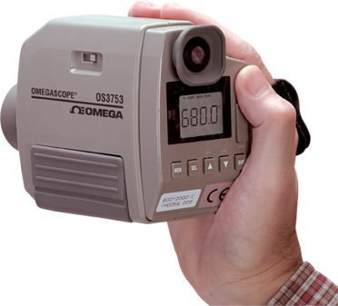
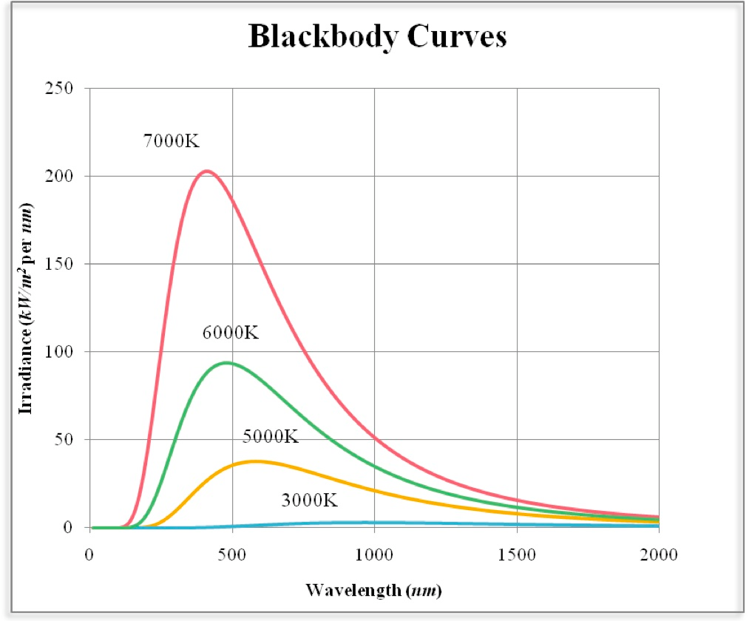
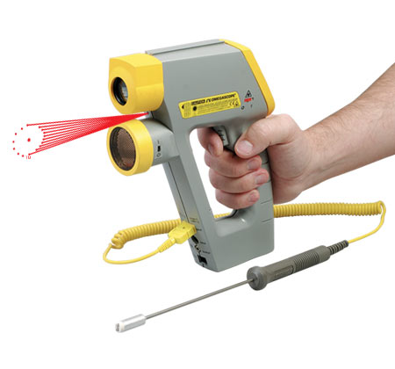
Pyrometer
Determines temperature from infrared blackbody radiation
Useful for non-contact, high-temeprature measurements
Omega.com

Slide 11
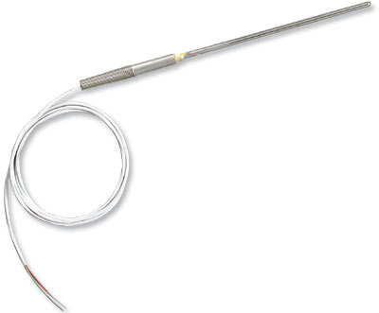
Temperature Measurements
RTD or Thermistor: 200 – 500K
Thermocouple: 200 – 1000K
Different “types” have different ranges
Pyrometer: T > 750K – “non-contact”
Omega.com
Omega.com

Slide 12
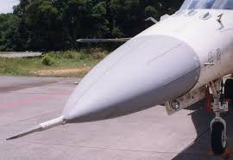
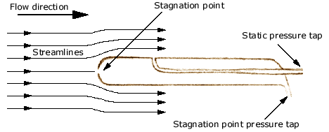
Pitot Static Probe
Measures fluid velocity u using Bernoulli’s law

Slide 13
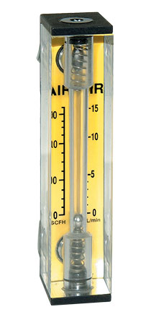
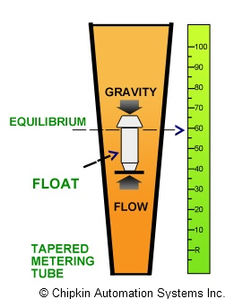
Rotameter
Measures flow rate.
Viscous drag causes a bead to levitate at a certain height.
Omega.com

Slide 14
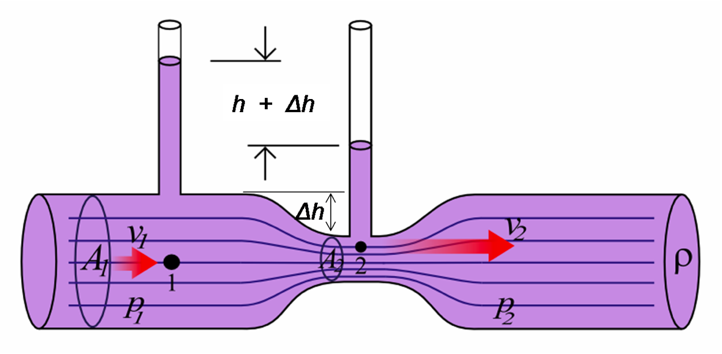
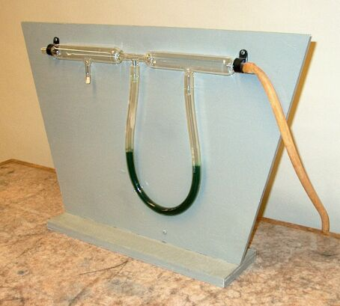
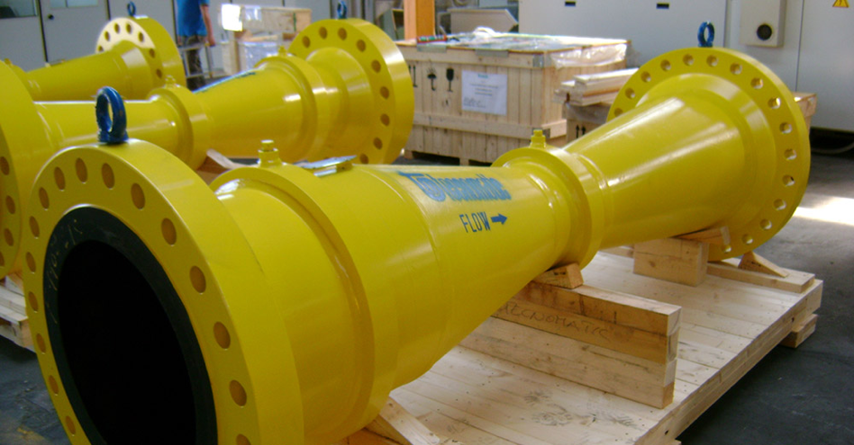
Venturi Tube
Some times called a “variable area flow meter”.
Uses Bernoulli’s law to measure flow rate Q = volume/sec.

Slide 15
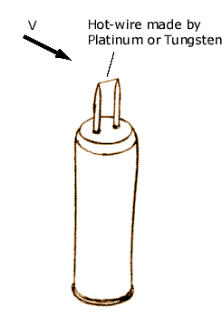
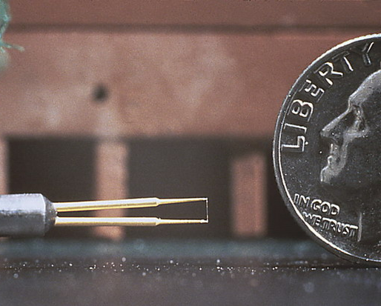
Hotwire Anemometer
Measures fluid velocity based on the convective cooling of a thin, heated wire.
Wire serves as both a resistive heater and as an RTD.

Slide 16
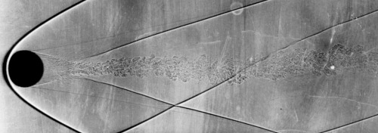
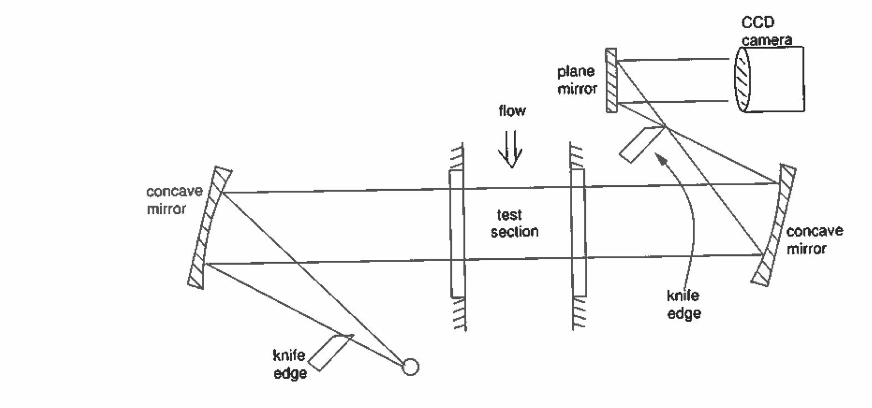
Schlieren Visualization
Optical system is highly sensitive to changes in gas density, often used to visualize shock waves in an hypersonic flow.
Fig. 4.17
Schlieren video: https://www.youtube.com/watch?v=JhlEkEk7igs (11:10)

Slide 17
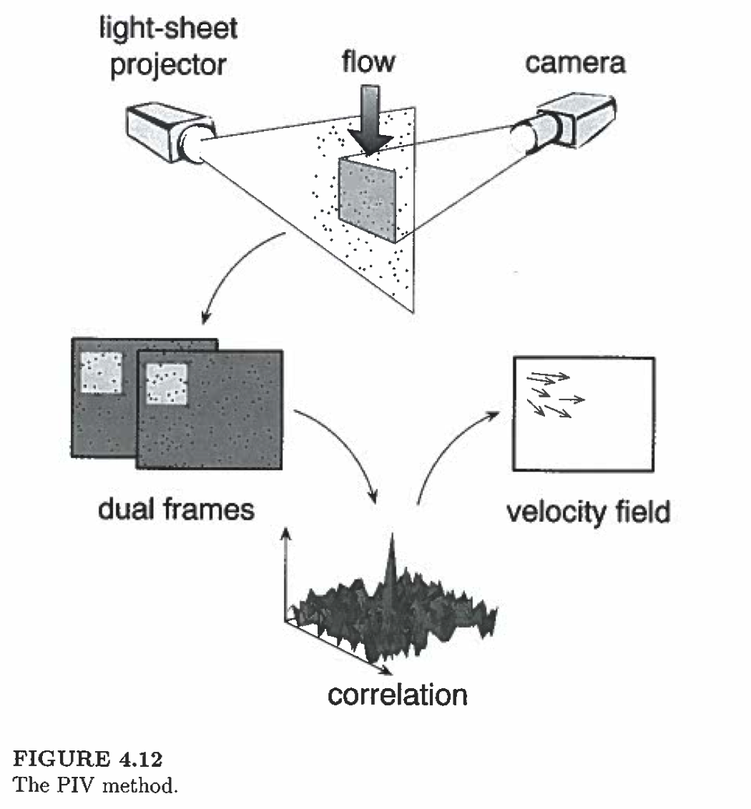
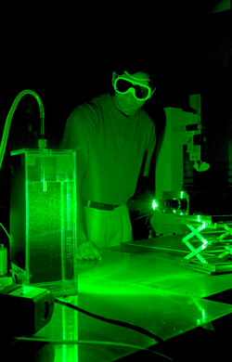
Particle Image Velocimetry
Compares two successive images of “seed particles”
532 nm green Nd:YAG laser
used as a flash bulb
https://web.engr.oregonstate.edu
Flow Visualization:
https://www.youtube.com/watch?v=nuQyKGuXJOs&index=5&list=PL0EC6527BE871ABA3 (11:00)

Slide 18
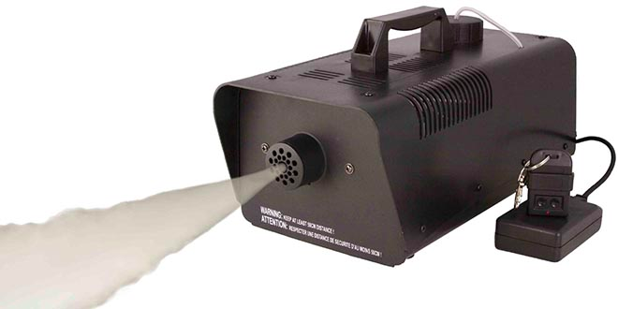
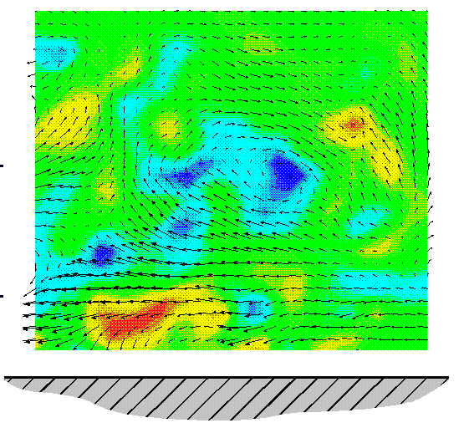

Particle Image Velocimetry
NACA Video: H2 Bubbles (11:00)
Fog machines work surprisingly well at creating seed particles in gas. Very small glass beads are often used in liquids.
http://research.ae.utexas.edu

Slide 19
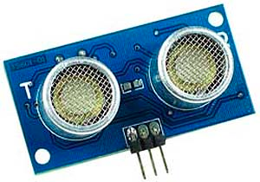
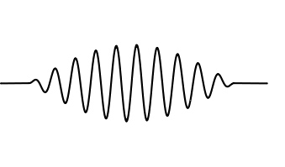
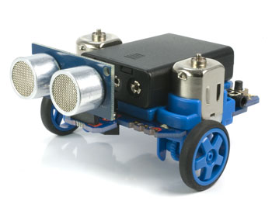
Ultrasonic Range Finder
Emits an ultrasonic pulse, waits for the echo
Δt
Uses the speed of sound to calculate distance

Slide 20
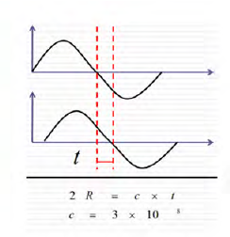
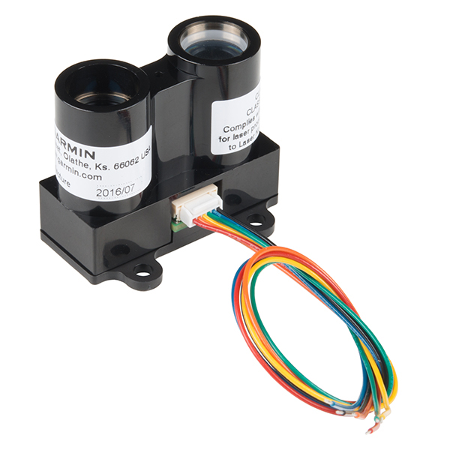
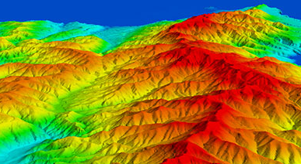
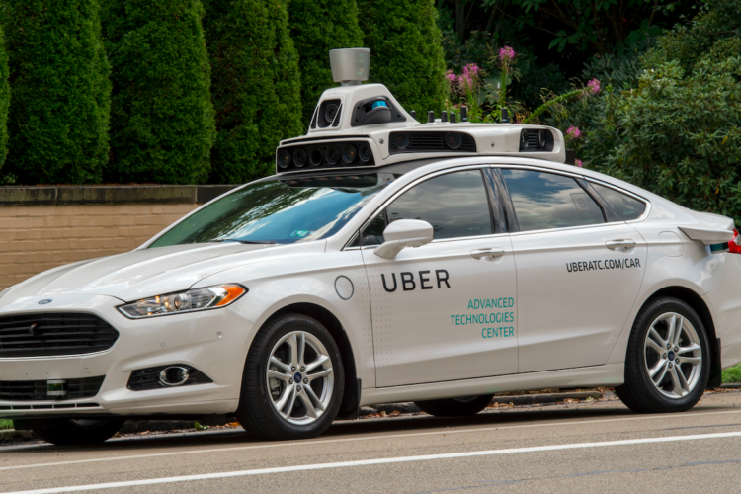
LIDAR
Light Detection And Ranging
Laser emits light, back-scatter or reflection recorded. Uses the speed of light to calculate distance.

Slide 21

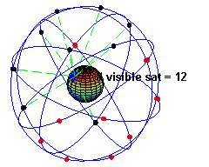
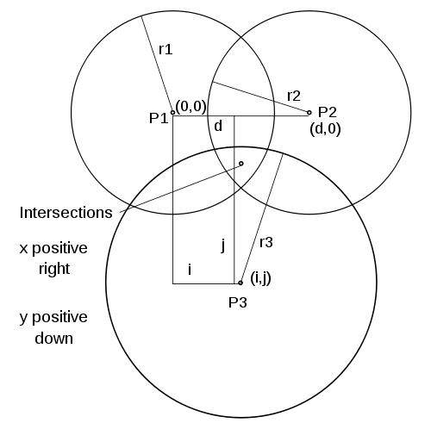
Global Positioning System
An array of 24+ satellites broadcast their current location and timestamp.
GPS receivers listen for signals from satellites.
The speed of light is used to calculate distance from each satellite
Trilateration is used to calculate the position of the receiver.

Slide 22
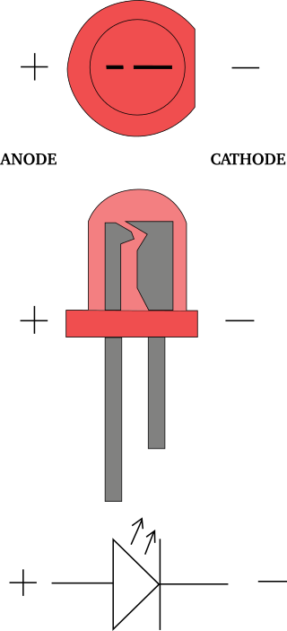
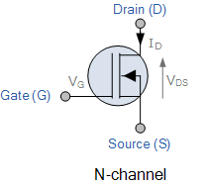
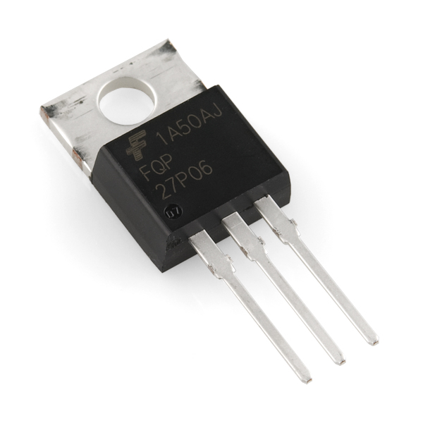
Semiconductor Devices
Diodes and LEDs
Transistors – Used for amplifiers and logic circuits

Slide 23
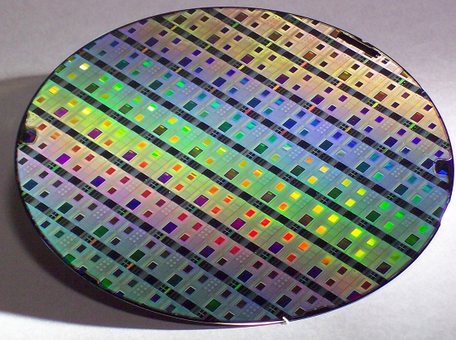
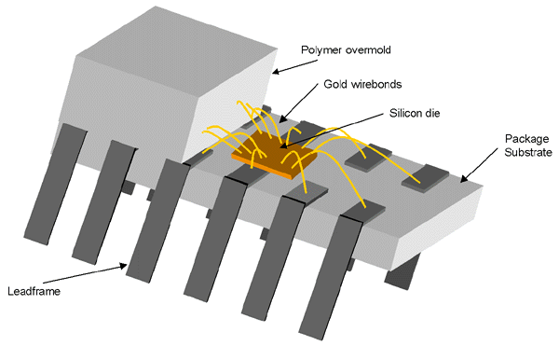
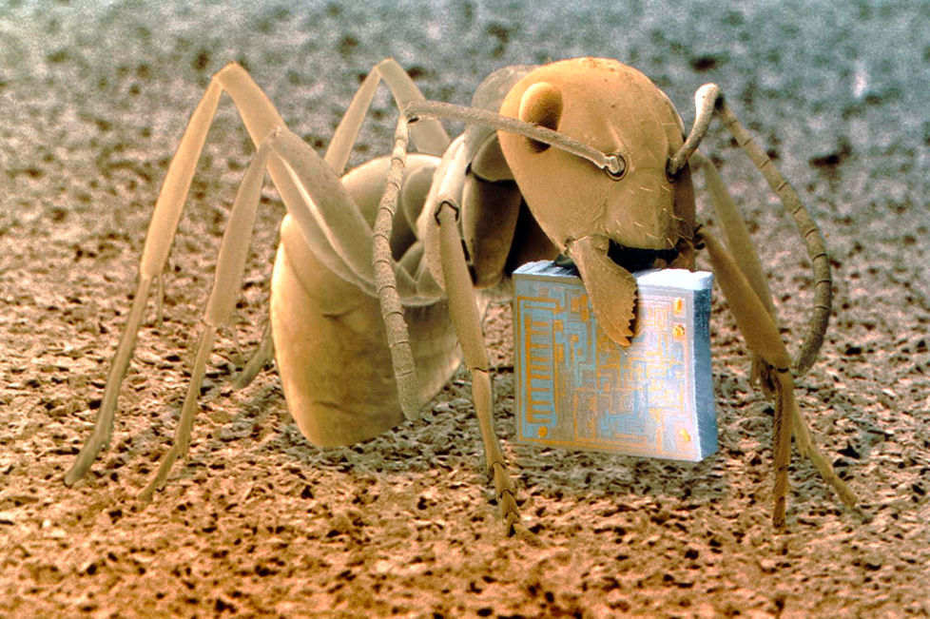
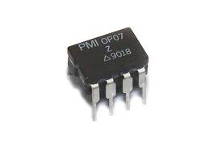
Integrated Circuits (I.C.s)
Wafers are diced up and packaged as IC chips.
DIP – “Dual inline package”

Slide 24
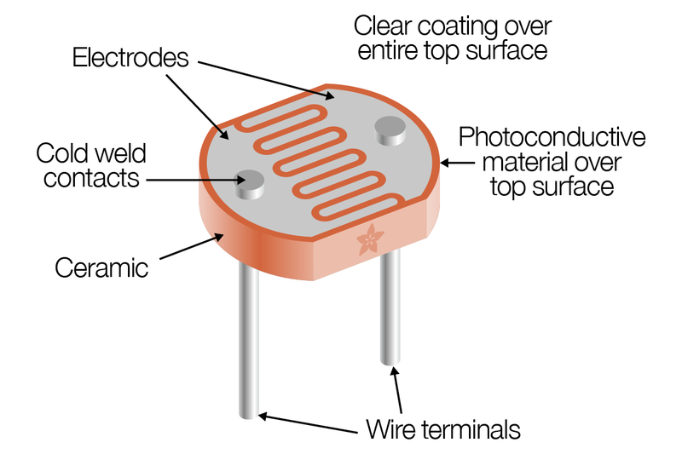
Cadmium Sulfide (CdS) Photocell
Resistance of Photocell changes when illuminated.

Slide 25


Orientation
Mechanical parts can rotate to various angles.
Robot football

Slide 26




Tachometers
Measures angular frequency ω or RPMs.
Some work based on magnetic inductance.
Others work optically
(i.e. Lab 1 PS3 fan speed)
Old fashioned ones are mechanical

Slide 27



Orientation
Potentiometers convert angle into a resistance.
Works like a voltage divider!

Slide 28
Quadrature Encoders
A Quadrature encoder counts electrical pulses as slotted wheel passes through a photocell.
Measures angular position and speed.

Slide 29

Attitude (Orientation)
Aircraft can rotate about 3-principle axes.

Slide 30


Gyroscopes
Attitude can be measured using a gyroscope.
Conservation of angular momentum causes flywheel to maintain its orientation.

Slide 31



Modern Accelerometers
“interdigitated” electrodes
Micro-Electro-Mechanical Systems (MEMS) have largely replace gyroscopes for intertial measurements.
3-axis gyro from an iPhone 4

Slide 32





Attitude Heading Reference System (AHRS)
Complete suite of accelerometers and gyroscopes for digital avionic systems.

Slide 33


Avionics

Slide 34



Vendors and Manufacturers
Basic electronic components – Jameco, Digikey, and Mouser
Omega Engineering Manufactures and sells many different temperature, pressure, and flow sensors
Honeywell
Manufactures and sells a variety of sensors commonly used in AME industry

